Slide 1

JAMIA ChatGPT Meta-Analysis Interface
By – Anubha Mahajan
By- Anubha Mahajan

Slide 2
About Me!
I am a third-year Computer Science major, focusing on the intersection of Machine Learning with Medicine

Slide 3
Table of contents
01
02
03
04
05
Introduction
Meta-Analysis
Interface
Case Study
Ongoing Research

Slide 4
01
Introduction

Slide 5
Goal
Enable the filtering of abstracts based on common inclusion/exclusion criteria
Enable the efficient extraction of clinical data from relevant studies

Slide 6




Motivation – Drug Repurposing
Aspirin
Original Use
?
Repurposed Use
Meta-analysis can cheaply identify effective new therapies using drugs already proven to be safe
Potential New Use

Slide 7






Motivation – Pharmacovigilance
vs
Meta-analysis can identify types and prevalence of side effects, and compare these between drugs

Slide 8



Purpose
LLMs
NLP
Large Language Models
Natural Language Processing
LBD
HITL
Automate
Literature Based Discovery
Human-in-the-Loop
Enhance clinical meta-analysis

Slide 9
02
Meta-Analysis

Slide 10
Meta-Analysis
Gold Standard
Process
Quantitative meta-analysis forms the gold standard for establishing clinical guidelines
It begins with a specific research question -> extract data elements to form a large, statistical cohort
Challenges
Limitations
A clinical meta-analysis done manually takes a year on average
Existing LLMs are prone to “hallucinations”

Slide 11






Process
Retrieve articles
Filter for relevance
Extract study data
Synthesize results

Slide 12
Example
Retrieve articles
Filter for relevance
Extract study data
Synthesize results
Research Question: What is the best medication regimen for adults with pyelonephritis?
(pyelonephritis[mesh]) AND (antibiotic[mesh])
(pyelonephritis[mesh]) AND (pharmacokinetic[mesh])
Include:
Clinical trials
Observational studies
Exclude:
Other meta-analyses
Non-clinical articles
Not drug-focused
Not focused on treating pyelonephritis
Outcomes not quantified
Studies in children
Population
Sample size
Patient characteristics
Intervention
Drug
Dosage
Route of administration
Comparator treatments
Outcomes
Study endpoint
Side effects
Quantitative measurements
Statistical significance
Synthetic cohorts
Statistical analysis
Report of results

Slide 13



Distribution of Labor
Retrieve articles
Filter for relevance
Extract study data
Synthesize results
Research Question: What is the best medication regimen for adults with pyelonephritis?
1 Day
2-6 Weeks
3+ Months
6-8 Weeks
6-8 Weeks
1 Person
1-2 People
3-7 People
1-2 People
1-2 People
Total: 10+ Months

Slide 14
03
Interface

Slide 15
Features
Dynamic Table
01
02
Custom Fields
Intuitive way for clinical researchers to expedite the process of literature review
Add data fields to be extracted or summarized from articles
Tagging
04
03
Filtering
Tag articles deemed “relevant” or “not relevant” for a given query
Filter data by keyword or using custom logic in a specific column
Citation Export
05
06
Authentication
Export a .cvs or .json file of the curated data for future use
Create secure accounts that have previous queries & results saved to review over several sessions

Slide 16
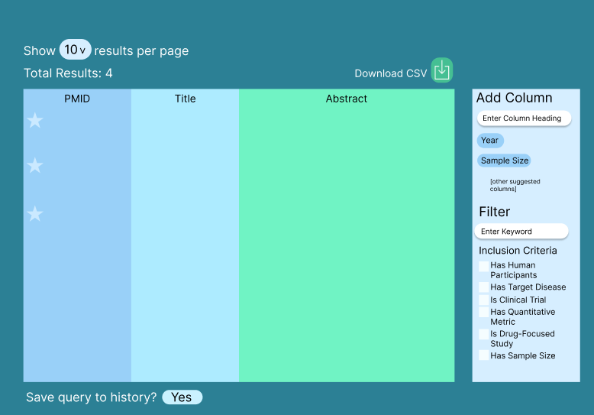
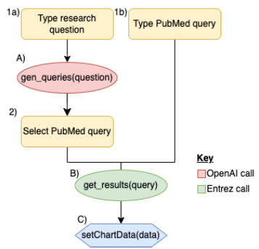
Implementation : Frontend
The interface was built using React + Next.js frontend
All frontend components were designed using Ally & Stark Accessibility Tools to ensure accessibility for individuals with disabilities
Figma Wireframe of the table
Study retrieval user scenario

Slide 17
Implementation: Backend
gen_pmids
gen_results
get_full_text
Takes in user-defined query and calls Entrez search to return the
PMIDS
Runs Entrez Fetch to find the title and abstract for each PMID
Calls Entrez Elink to find the full text link
add_column_async
cost_estimate
Calls asynchronous OpenAI functions
Calls tiktoken to estimate how many tokens this will cost OpenAI

Slide 18
Methodology
Study Retrieval
Data Extraction
Renders the table with relevant PubMed articles & data fields based on clinicians’ research query
Prompted to enter the attribute(s) to extract from the articles with an option to provide an example/format

Slide 19
04
Case Study

Slide 20
Screening & Filtering Abstracts
CASE STUDY – Glioblastoma
PubMed Query follows the format: (disease_name) AND (DRUG) AND (FILTERS)
Used a list of 124 unique drugs from the Remedy Cancer Database
The search pattern retrieved 128 articles
The filtering prompts identified 69 (R) and 59 (NR) articles
7 false negatives in the NR category
Excluding experimental drugs resulted in 44 true positives
For the creation of a focused dataset, the 7 filtering metrics employed included:
Does the abstract focus on human subjects?
Does the abstract include the target disease?
Is the abstract a clinical trial (study type)?
Does the abstract focus on one or more drugs that can be repurposed for Glioblastoma (i.e. drugs not approved for Glioblastoma treatment)?
Does the abstract include quantified outcome measures such as progression-free survival, overall survival, etc.?
Does the abstract include data on population size?
Does the abstract include an intervention group?

Slide 21
Extracting Clinical Data
PICO framework was utilized to extract key clinical data from the filtered abstracts, including the following attributes:
{“study type”,
“drug_name”,
“treatment_timing”,
“drug_dosage”,
“standard_of_care”,
“sample_size”,
“groups”,
“side_effects”,
“primary_outcomes”}

Slide 22
03
Ongoing Research

Slide 23
Study Types
RAG
Statistical methods
Including specific fields for each study type
Retrieval Augmentation Generation
Addition of different statistical methods

Slide 24
Thank you! amahajan68@gatech.edu

